Slide 1
Genuine feedback system
The Machinists - Technothon 2k16

Slide 2
Introduction
Problem Statement : To create a smart system that generates genuine feedback based on the parameters of tone and facial expressions.
Motivation : In the previous Technothon, we saw a lot of ‘friends’ trying to bump up the overall score of a team by injecting falsified feedback. Not only does this give the presenting team an unfair advantage, but it also hampers the overall genuine scope of the project. This motivated us to make an application that generates genuine feedback.

Slide 3
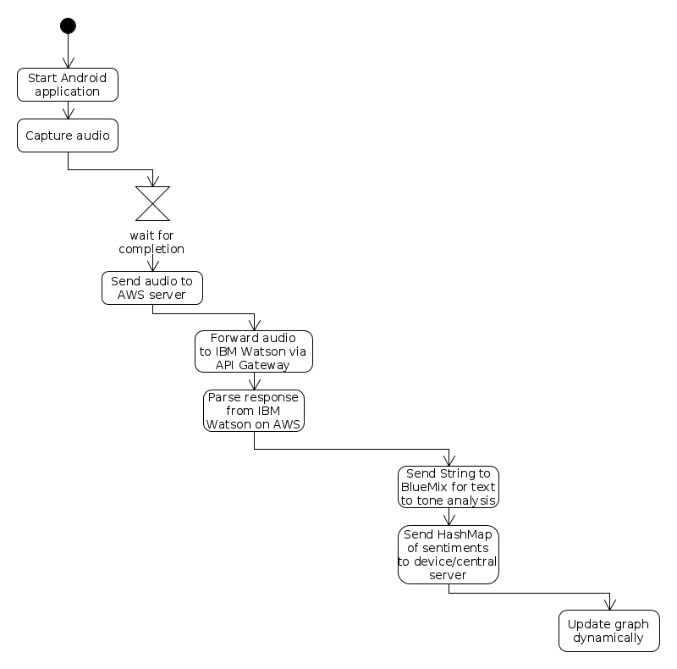
Architecture

Slide 4
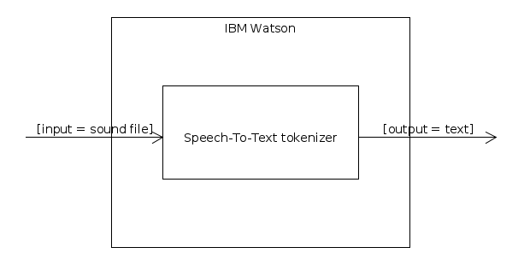
Speech to Text

Slide 5
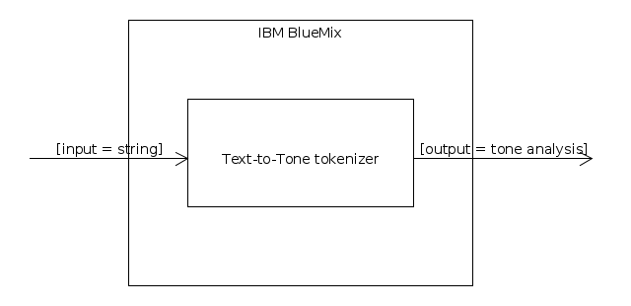
Tone analysis

Slide 6
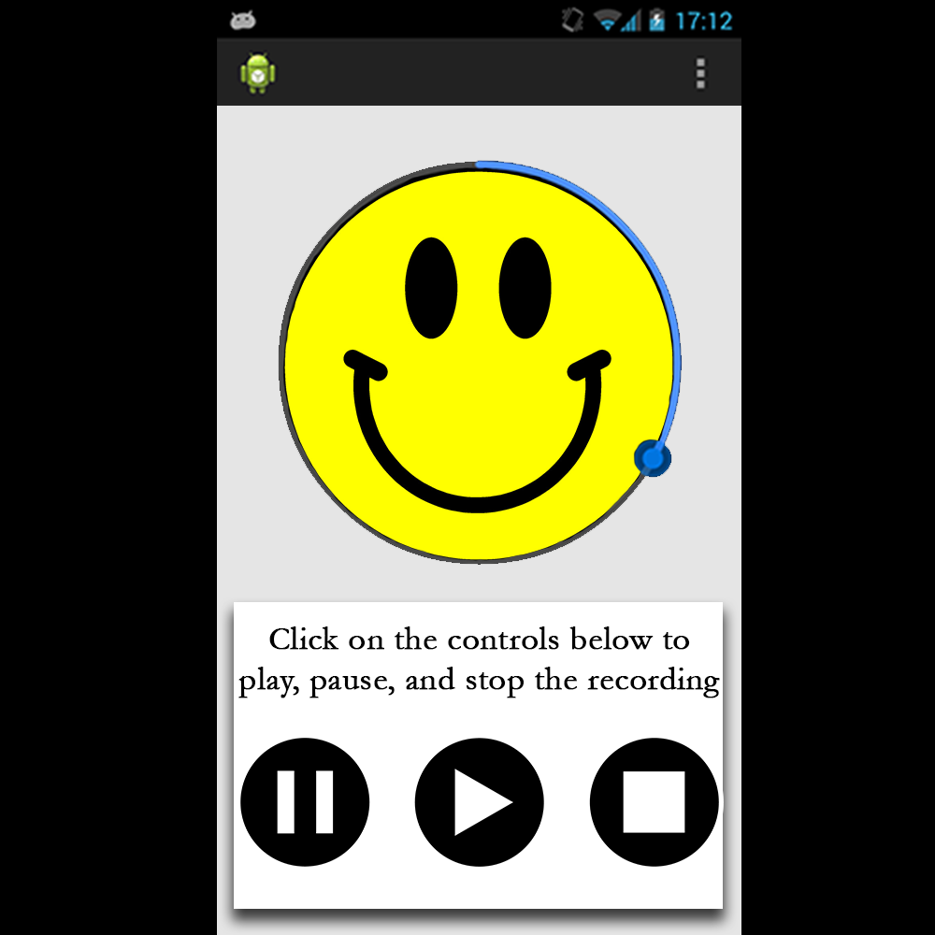
Android Voting and
Recording
Application

Slide 7
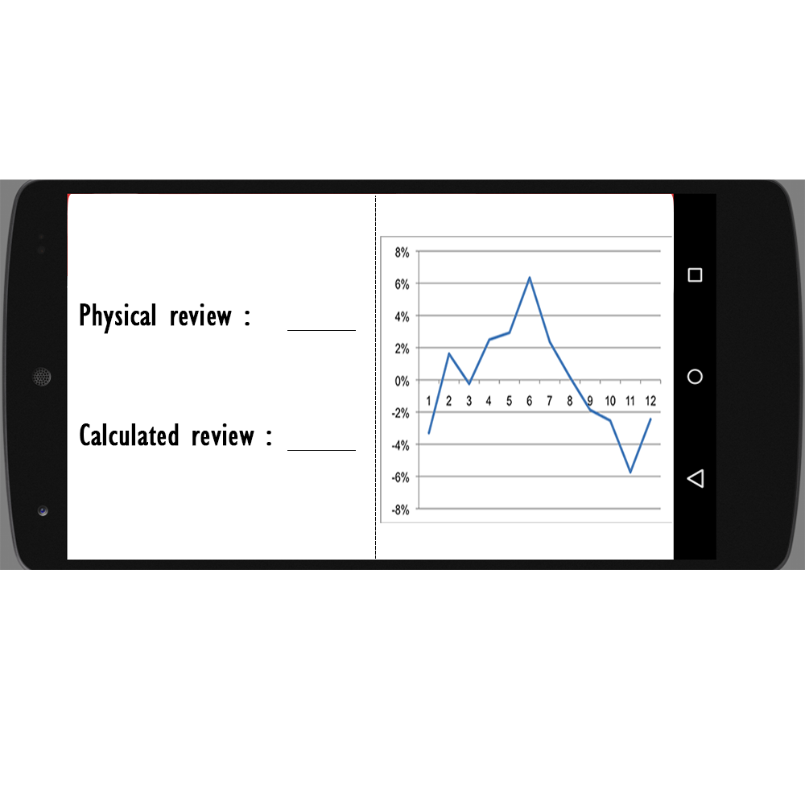
Expected
Output (I)

Slide 8
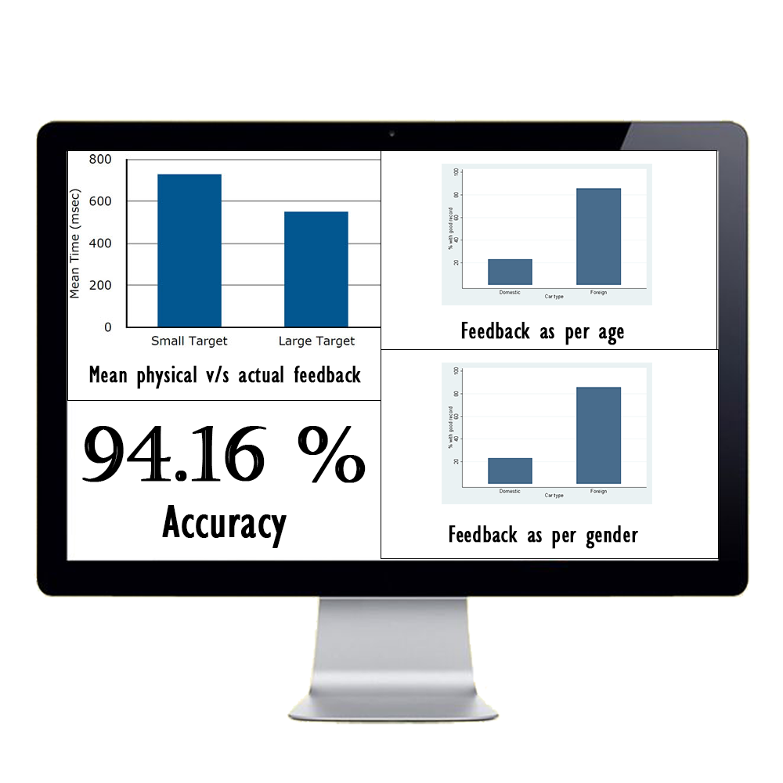
Expected
Output (II)

Slide 9
Thank You!

